Slide 1


Dualog Mail
Anglo-Eastern Ship Management
Operational Discussion
14th October 2025

Slide 2




Dualog Mail Deployment Status
Dualog business mail – Phase 1 : Deployed 287 vessels so far
Dualog business mail – Phase 2 : Role based login – Pending testing phase with One net

Slide 3
Dualog Mail – Operational Discussion
Pending message is flooding
Email forwarding done so early, jam up the pending queue, new vessel need to download all these messages before commission of Dualog business mail – not ideal
Can we do email forwarding 1 months before real-activation of vessel, or do it when we intend to activate the vessel ?

Slide 4
Dualog Mail – Operational Discussion
V Drive – IMAP Backup
Backup Drive for IMAP backup, this is a critical operation process to backup email history of the vessel mailbox
Not all vessel configured with V Drive still….

Slide 5
Dualog Mail – Operational Discussion
Request for support assistance
If there is a need for Dualog support to remote access
Provide all critical information such as token access URL and
- Callsign : Password
- aeship : Password

Slide 6
Dualog Mail – Operational Discussion
Request for support assistance
Vessel IT do basic initial assessment of the issue
Dualog Support might not remote in immediate and request for follow-up troubleshooting via Vessel IT with Captain
Support cases tend to drag quite long between Vessel IT and Dualog Support
What is the support expectation and response time?
What is the GCC Operating hours

Slide 7
Dualog Mail – Operational Discussion
Request for support assistance
So far, We observe 75% of the support ticket is related to MS Outlook issue.
Outlook sync issue
Outlook message delayed
Outlook operational error
Outlook sync blocked between Dualog imap server

Slide 8
Dualog Mail – Operational Discussion
Outlook IMAP sync issue
- Outlook Sync issue
6 months after deployment, we noticed increased number of vessels reported Outlook sync issue
- Investigation Report on Outlook Issue
- Ver 5.11 – Fix Outlook Rename Abnormality
- Compile new deployment script with Ver 5.11 shared with GCC Team
- Darren testing for first 20 vessels, fine-tuned ps script shared with GCC Team for rest of the existing vessels –
-Need token assistance , comm pc, cheng pc, nav pc, choff pc

Slide 9
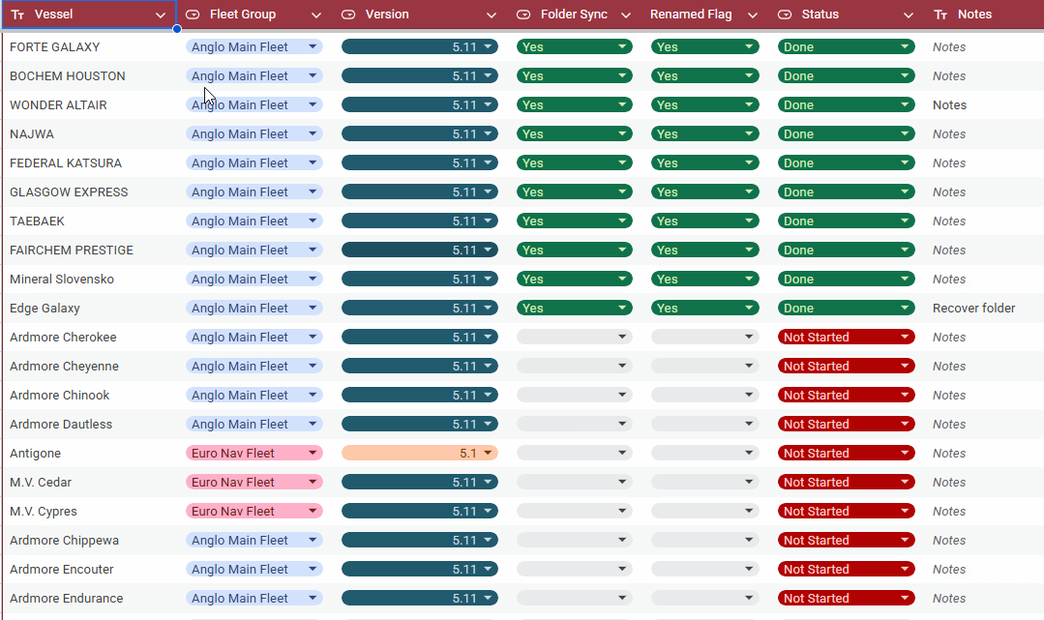
Dualog Mail – Operational Discussion

Slide 10
Thank you.

